Slide 1
Around the World in 180 Days
Susie Oh
Information Literacy Instructor
Lake Forest School District 67

Slide 2
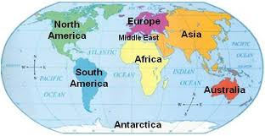
The World

Slide 3
If the World Were a Village…
Take all the world’s population and imagine it as a village of just 100 people. Each person would represent 70 million people from the world.

Slide 4
Nationalities
Of the 100 people in the global village:
_____ are from Asia

Slide 5
Nationalities
Of the 100 people in the global village:
61 are from Asia
____ are from Africa

Slide 6
Nationalities
Of the 100 people in the global village:
61 are from Asia
14 are from Africa
____ are from Europe

Slide 7
Nationalities
Of the 100 people in the global village:
61 are from Asia
14 are from Africa
11 are from Europe
____ are from South America, Central America, and Caribbean

Slide 8
Nationalities
Of the 100 people in the global village:
61 are from Asia
14 are from Africa
11 are from Europe
8 are from South America, Central America, and Caribbean
____ are from Canada and U.S.

Slide 9
Nationalities
Of the 100 people in the global village:
61 are from Asia
14 are from Africa
11 are from Europe
8 are from South America, Central America, and Caribbean
5 are from Canada and U.S.
____ is from Oceania

Slide 10
Nationalities
Of the 100 people in the global village:
61 are from Asia
14 are from Africa
11 are from Europe
8 are from South America, Central America, and Caribbean
5 are from Canada and U.S.
1 is from Oceania

Slide 11
Nationalities
Of the 100 people in the global village:
____ are from Asia
____ are from Africa
____ are from Europe
____ are from South America, Central America, and Caribbean
____ are from Canada and U.S.
____ is from Oceania

Slide 12
Population
____ are from China

Slide 13
Population
20 are from China
____ are from India

Slide 14
Population
20 are from China
17 are from India
____ are from the U.S.

Slide 15
Population
20 are from China
17 are from India
5 are from the U.S.
____ are from Indonesia

Slide 16
Population
20 are from China
17 are from India
5 are from the U.S.
4 are from Indonesia

Slide 17
Population
20 are from China
17 are from India
5 are from the U.S.
4 are from Indonesia
3 are from ___________
3 are from ___________

Slide 18
Population
20 are from China
17 are from India
5 are from the U.S.
4 are from Indonesia
3 are from Brazil
3 are from Pakistan

Slide 19
Population
____ are from China
____ are from India
____ are from the U.S.
____ are from Indonesia
3 are from _____________
3 are from _____________

Slide 20
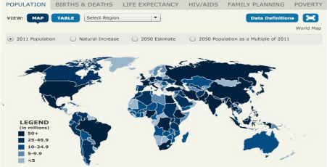
Population Map

Slide 21
Languages
The top 5 languages spoken in the world are:
Chinese
English
Hindi
Spanish
Arabic

Slide 22
Water
87 have access to safe water
13 do not and must spend majority of their day getting water (done mostly by women and girls)

Slide 23
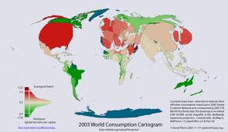
Water Consumption Cartogram

Slide 24
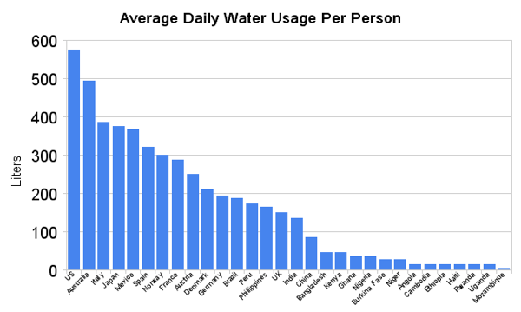
Water Use by Country

Slide 25
Money
If money were divided equally, each person would have $10,300
The richest 10 people have nearly 85% of world’s wealth ($87,500 a year)
The poorest 10 people have less than $2 a day
47 do not always have enough to eat

Slide 26
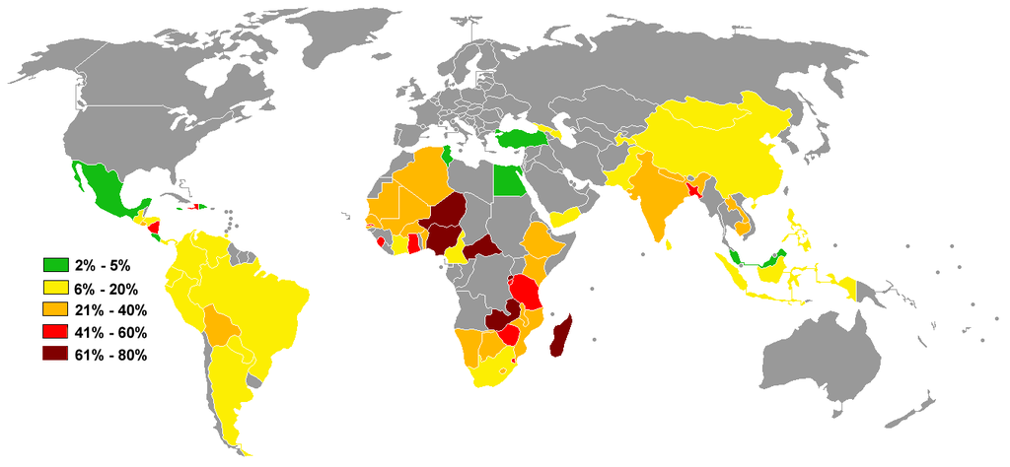
People living on less than $1/day

Slide 27
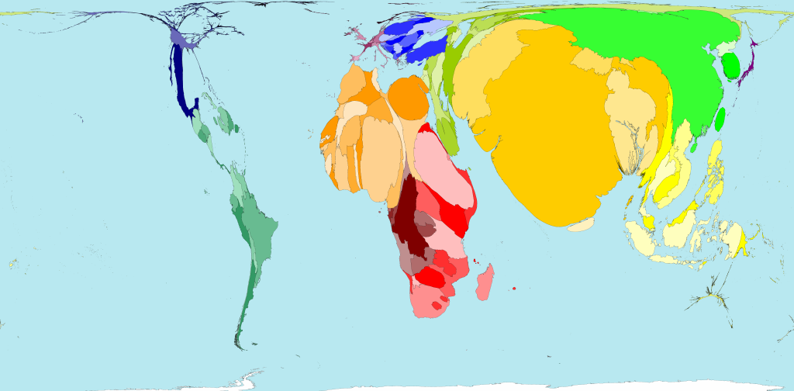
World Poverty Map

Slide 28
Energy
76 have electricity
24 do not have electricity

Slide 29
Problem-based projects
Global issues:
Poverty
Global warming
Hunger
Deforestation
Overpopulation
Pollution

Slide 30
Social justice issues
Water
Education
Gender
Human rights

Slide 31
International Education and Resource Network
The largest school network focusing on pedagogies involved in creating collaborative, project-based work for students all over the world
http://www.iearn.org/

Slide 32
KidLink
Kids join in global projects. An easy way to introduce global issues to elementary students through projects that find commonalities among students around the world.
http://www.kidlink.org

Slide 33
ePals
Allows students to find “pen pals” on the web
http://www.epals.com/

Slide 34
Global Schoolhouse
A collaborative network that incorporates online learning for students
http://globalschoolnet.org/

Slide 35
Feeding Minds Fighting Hunger
This program was launched as part of an iEARN project. Includes teaching modules for all grade levels
http://www.feedingminds.org

Slide 36
Global Nomads Group
International NGO that creates interactive educational programs for students about global issues
http://gng.org/

Slide 37
Simulation Game
This game role-plays a poor family in Haiti. They ask the question, “What is it like to live in poverty, struggling every day to stay healthy, keep out of debt, and get educated?”
http://www.tigweb.org/tiged/projects/ayiti/game.html

Slide 38
Flat Classroom Project
A classroom project based on Tom Friedman’s book The World Is Flat
http://www.flatclassroomproject.org/

Slide 39
1001 Flat World Tales
A global writing workshop between international and public schools around the world
http://burell9english.wikispaces.com/

Slide 40
Stories from around the world
Fairy tales, folktales, myths, legends, tall tales
Irish Cinderella: Fair, Brown and Trembling

Slide 41
Culture Quilt
A patchwork of cultures: Who am I?
http://www.sdcoe.net/score/patch/patchtg.html

Slide 42
Food
Foods from around the world
Bread, noodles, rice, etc.
Spices
Spices of the world
Spices in your favorite food

Slide 43
Holidays
Compare/contrast holidays
Thanksgiving around the world
http://everettirc.weebly.com/resources.html

Slide 44
Quick and easy
Question of the Day
This Day in History
Current events
Newseum
World News for Kids

Slide 45
Video on globalization

Slide 46
Resources
http://www.ipl.org/div/cquest/
http://www.socialstudiesforkids.com/subjects/cultures.htm
http://katw.org/index.cfm

